Slide 1

DropAttack: Leveraging Realistic Templates for Enhanced Universal Adversarial Attacks on Detectors
Subrat Kishore Dutta, Somrita Ghosh, Soham Roy

Slide 2
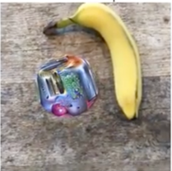
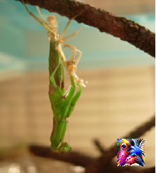
Adversarial patch attack
GP
LAVAN
Image credit: [6,9]
Notes:
Somrita

Slide 3
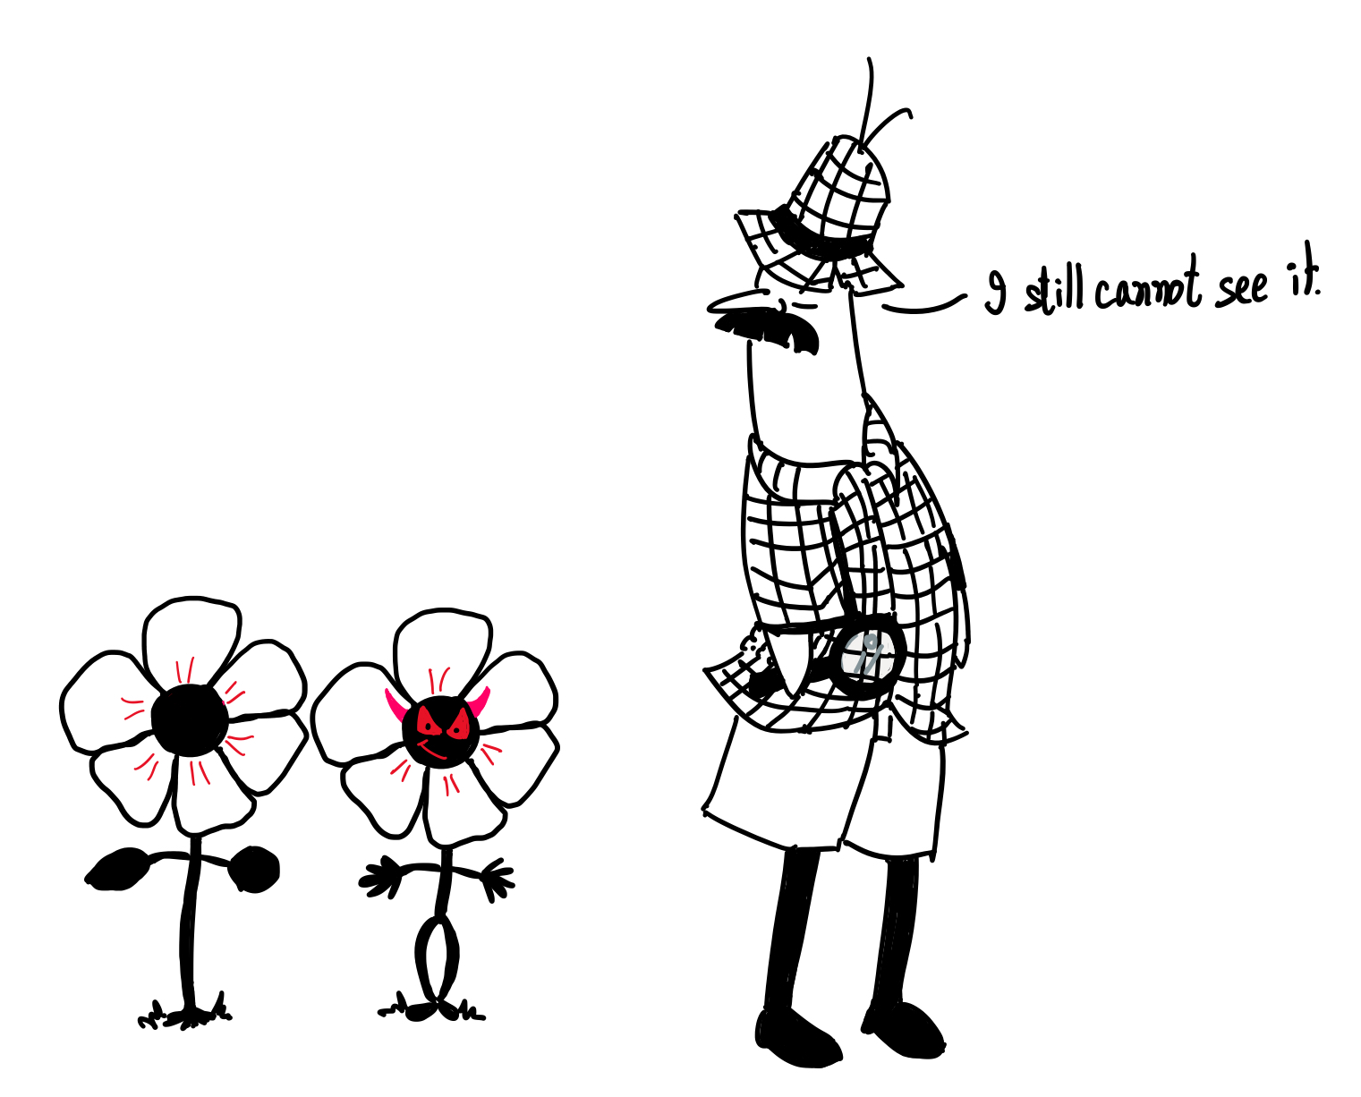
Achieving invisibility
Two ways to be sneaky…
Notes:
Somrita

Slide 4
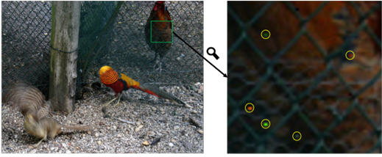
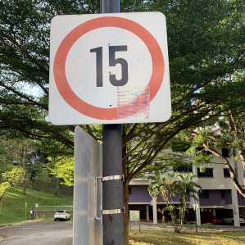
Achieving invisibility
Firstly be Imperceptible
Image credit: [5,10]
Notes:
Somrita
The second method aims to make the patch entirely imperceptible, requiring close attention to become visible.

Slide 5
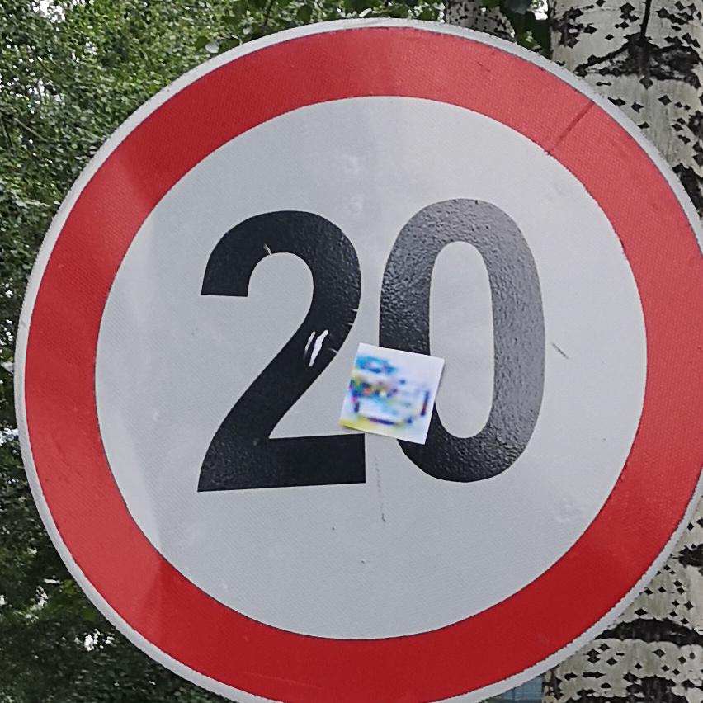
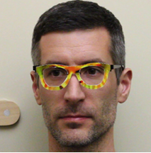
Achieving invisibility
Secondly be Inconspicuous
Image credit: [7,8]
Notes:
Somrita
There are two methods to ensure a patch goes unnoticed. The first involves making the patch inconspicuous, blending it with the image's context to prevent suspicion even if it's visible thus exploiting prior human knowledge to their advantage. The second method aims to make the patch entirely imperceptible, requiring close attention to become visible.

Slide 6
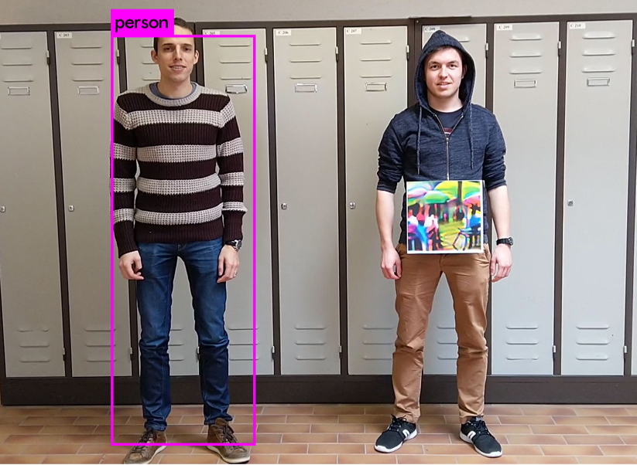
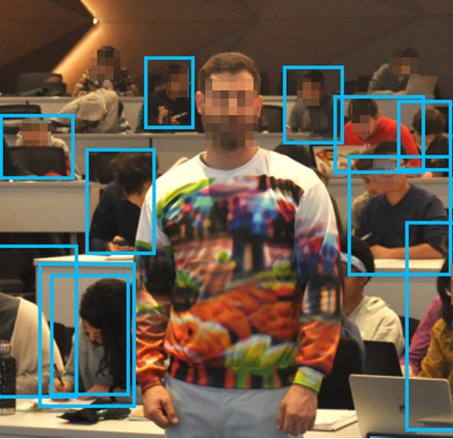
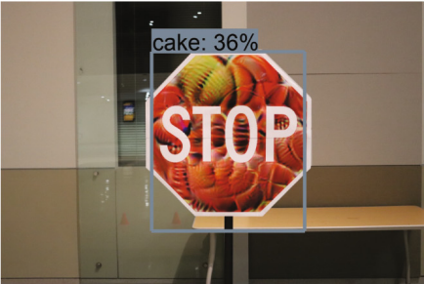
Adversarial patch attack on object detectors
Image credit: [1,2,4]
Notes:
Now, we come to attack on object detectors in the real world. Usually these attacks mainly focus on inconspicuousness because achieving imperceptibility on real world attack is hard.

Slide 7
Adversarial patch attack on object detectors
Access to the object instances is required!!
Image credit: [1,2,4]
Notes:
Disadvantage: access to the object is required.

Slide 8
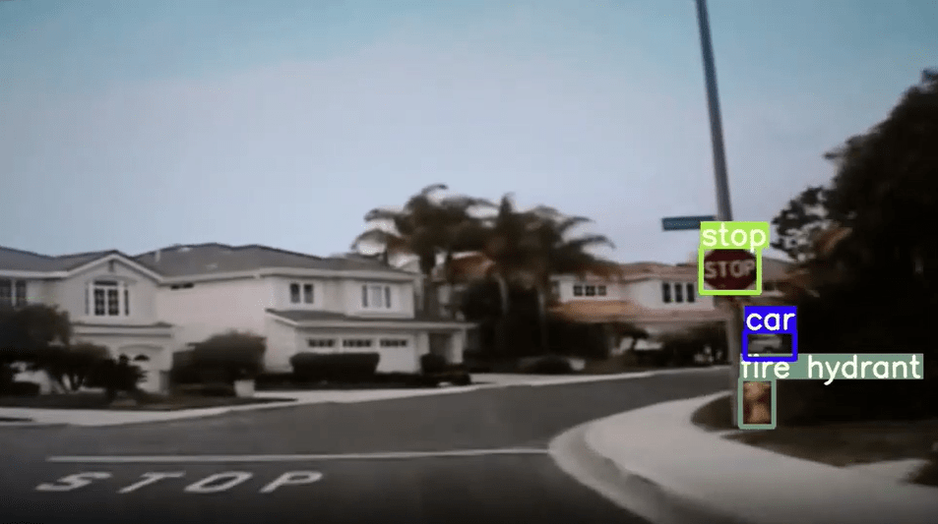
The translucent patch
Image credit: [11]
Notes:
(Explain the process)This was the first work that designed an attack that doesn't require access to the object. The patch is printed like a sticker and applied on the camera lens. It is focused on doing targeted attack by preventing detction of certain classes.

Slide 9
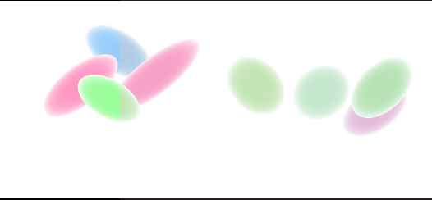
The translucent patch
+
Image credit: [11]
Notes:
This was the first work that designed an attack that doesn't require access to the object. The patch is printed like a sticker and applied on the camera lens. It is focused on doing targeted attack by preventing detction of certain classes.

Slide 10
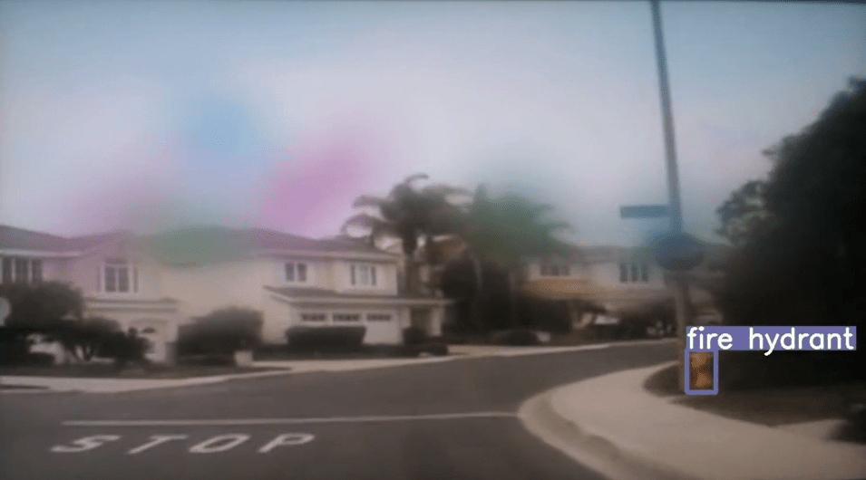
The translucent patch
+
=
Image credit: [11]
Notes:
This was the first work that designed an attack that doesn't require access to the object. The patch is printed like a sticker and applied on the camera lens. It is focused on doing targeted attack by preventing detction of certain classes.
Optimisation(Shape+position+colour)

Slide 11
The translucent patch: Drawback
+
=
Increase in number of shapes causes overlapping causing saturation of the attack success.
Increased perceptibility.
Image credit: [11]
Notes:
2. Even if the patches are not clearly visible the resultant perturbed image will be very unclear

Slide 12
Our method:
Preparing the mask
Initialising the perturbation tensor
Application of the patch
Optimizing the patch
Loss function
Notes:
Subrat

Slide 13

Our method: Preparing the mask
Template image

Slide 14
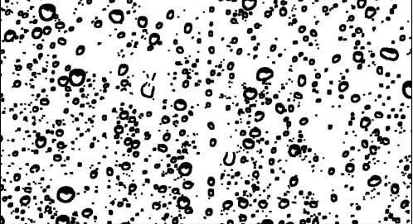
Our method: Preparing the mask
Template image
Binary thresholding and eroding

Slide 15
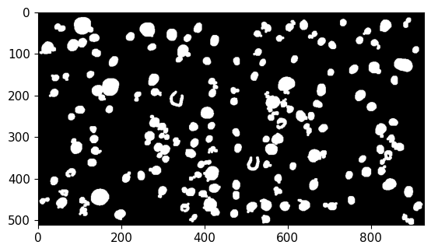
Our method: Preparing the mask
Template image
Binary thresholding and eroding
Area thresholding

Slide 16
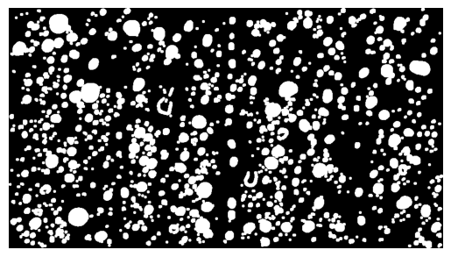
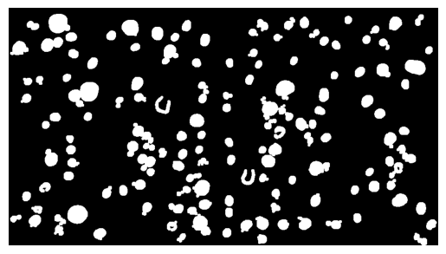
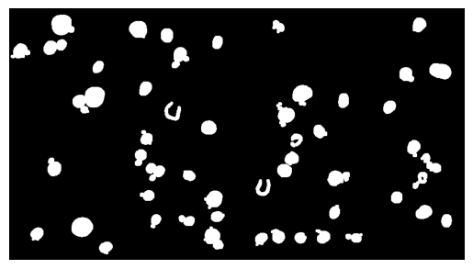
Our method: Preparing the mask
Template image
Binary thresholding and eroding
Area thresholding
Area threshold increases

Slide 17
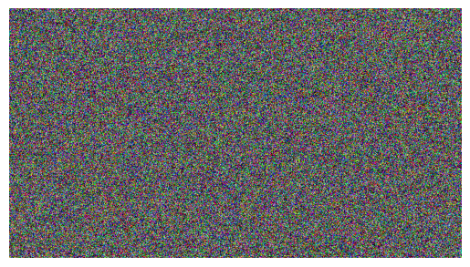

Our method: Initialising the perturbation tensor
Random values sampled from Normal Distribution
Normalised grey value

Slide 18
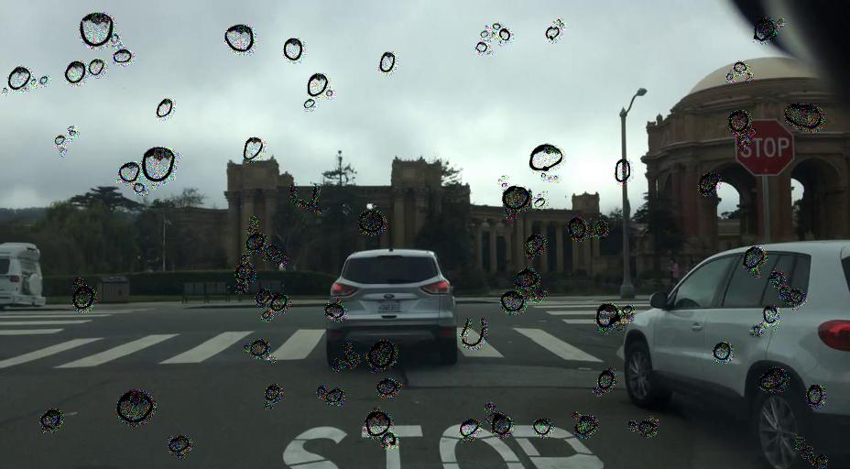
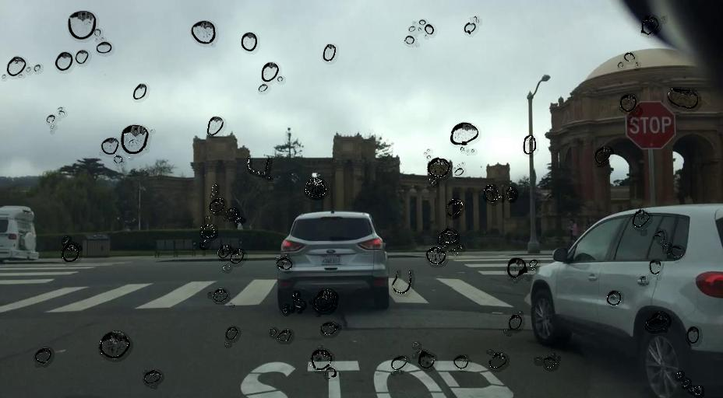
Our method: Application of the patch
Random initialised
Grey value initialised

Slide 19
Our method: Application of the patch
Random initialised
Grey value initialised
We use the greyscale image of the template as alpha map

Slide 20
Our method: Application of the patch
Psychological advantages:
Saliency mimics dispersion effect
Grey value is less salient

Slide 21
Our method: Optimizing the patch
For random initialized patch we used Adam Optimizer.

Slide 22
Our method: Optimizing the patch
For random initialized patch we used Adam Optimizer.
For grey value initialized patch:

Slide 23
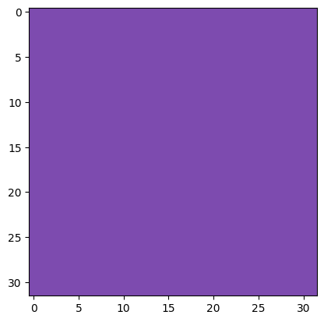
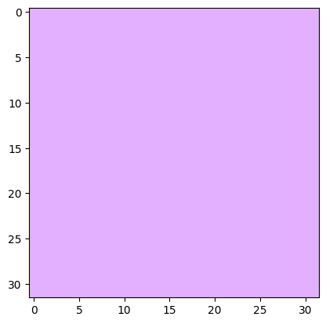
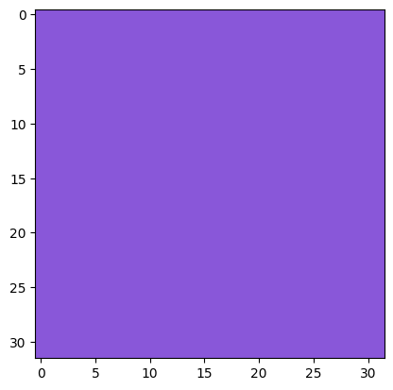
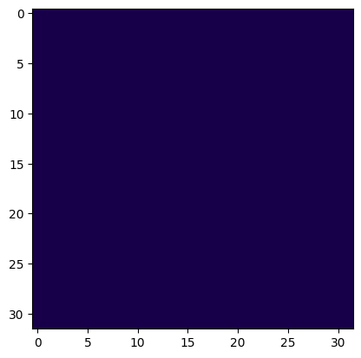
Our method: Optimizing the patch
For random initialized patch we used Adam Optimizer.
For grey value initialized patch:
Update Brightness and Saturation and NOT Color
original
Changing the saturation and brightness and not the colour

Slide 24
Our method: Loss function
Notes:
Somrita

Slide 25
Our method: Loss function
: Targeted class loss

Slide 26
Our method: Loss function
: Targeted class loss
: Untargeted class loss

Slide 27
Our method: Loss function
: Targeted class loss
: Untargeted class loss
: Variation loss

Slide 28
Our method: Loss function
: Targeted class loss
: Untargeted class loss
: Variation loss
: Regularization term

Slide 29
Evaluation
Attack success measure:
Average precision
Fooling rate
Our targeted classes: stop sign, traffic lights
Our victim model is: YOLOv5

Slide 30
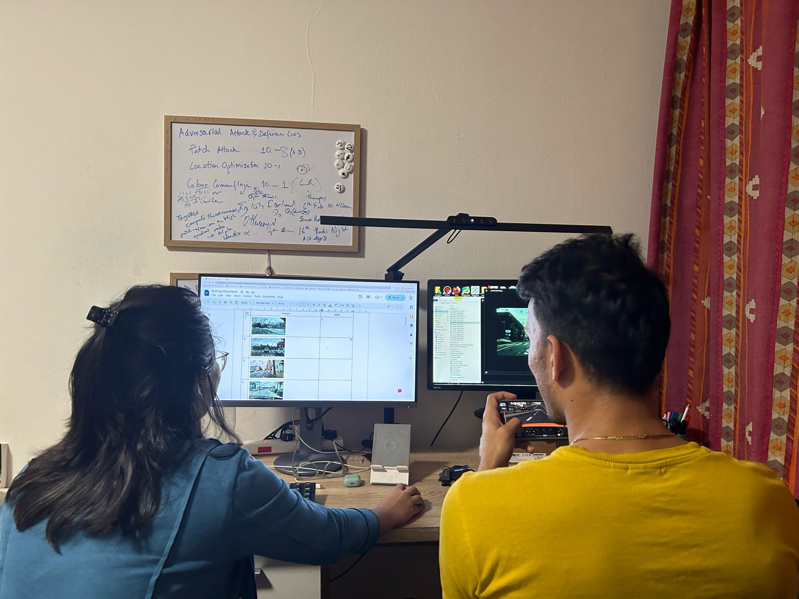
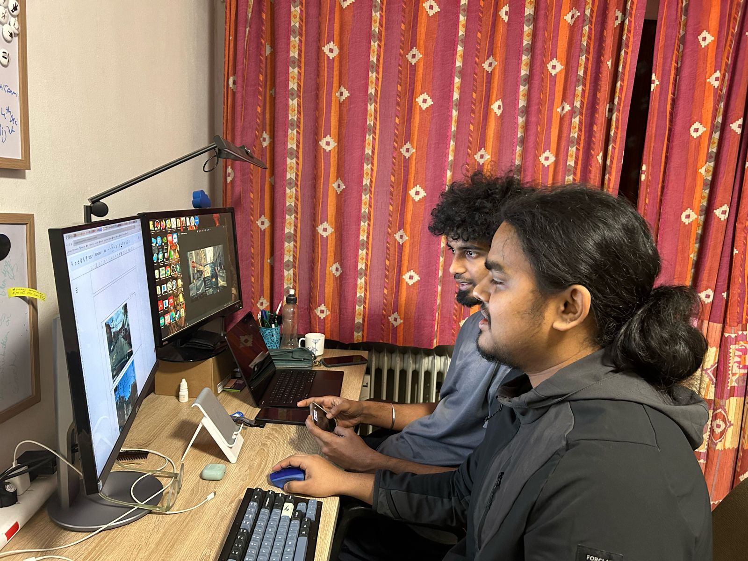
Human evaluation
Notes:
So we had 10 participants for the evaluation section. We gave them a primary task (here playing a game) and asked them to detect if they see any abnormalities in the images we show them.

Slide 31
Human evaluation
average inconspicuousness score : 0.68
Notes:
So we had 10 participants for the evaluation section. We gave them a primary task (here playing a game) and asked them to detect if they see any abnormalities in the images we show them.

Slide 32
Results: Per class Average Precision
Study | Area/number of shapes(N) | Initialisation | "stop sign" Class | Other Class
Ours | 200 | grey | 41.01 | 66.61
Zolfi et. al | 15(N) | _ | 47.9 | 72.49
Notes:
Subrat

Slide 33
Results: Per class Fooling Rate
Study | Area/number of shapes(N) | Initialisation | "stop sign" Class | Other Class
Ours | 200 | grey | 47.81 | 27.2
Zolfi et. al | 15(N) | _ | 42.27 | 21.54

Slide 34
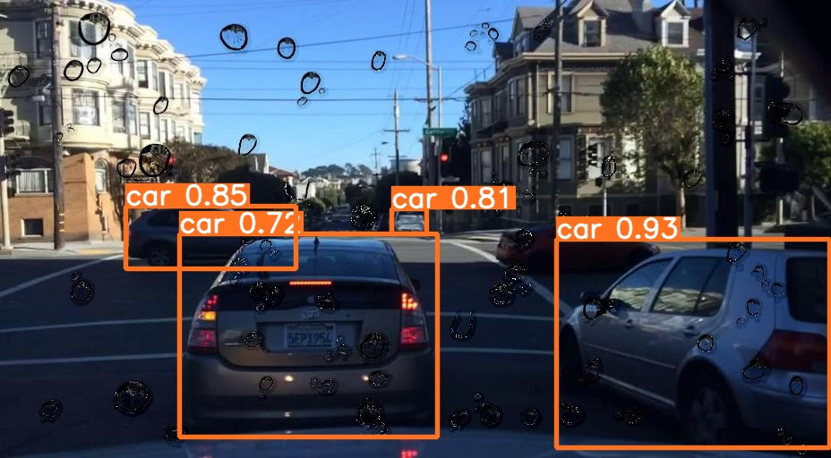
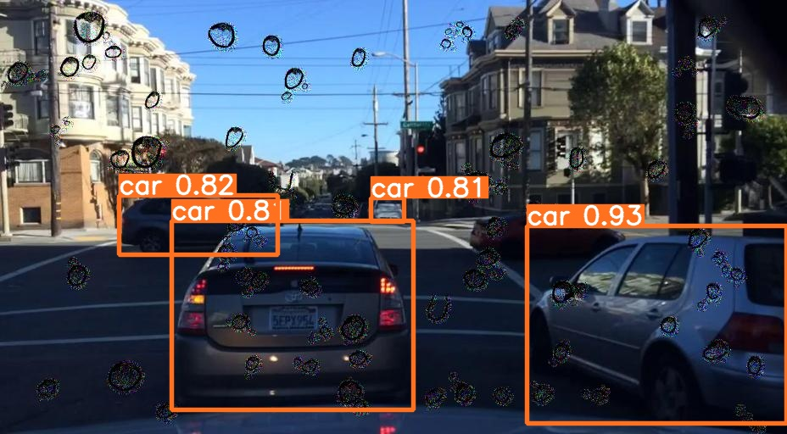
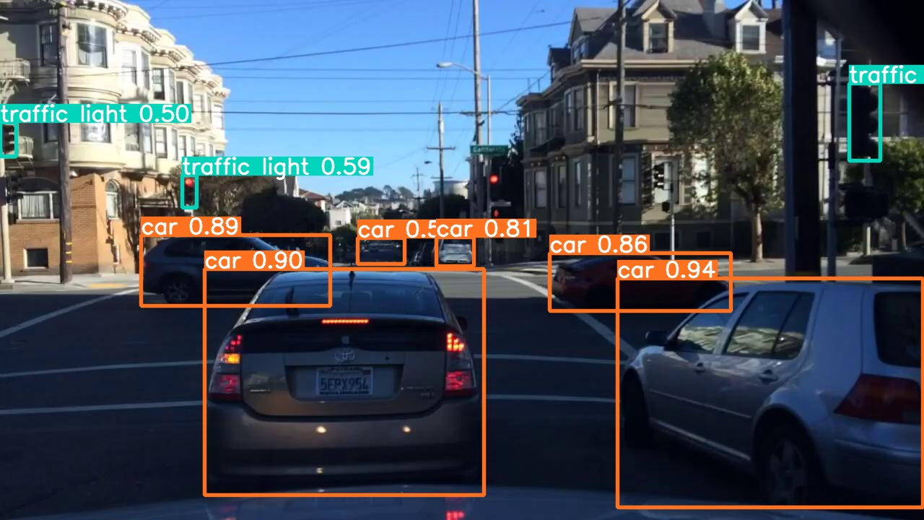
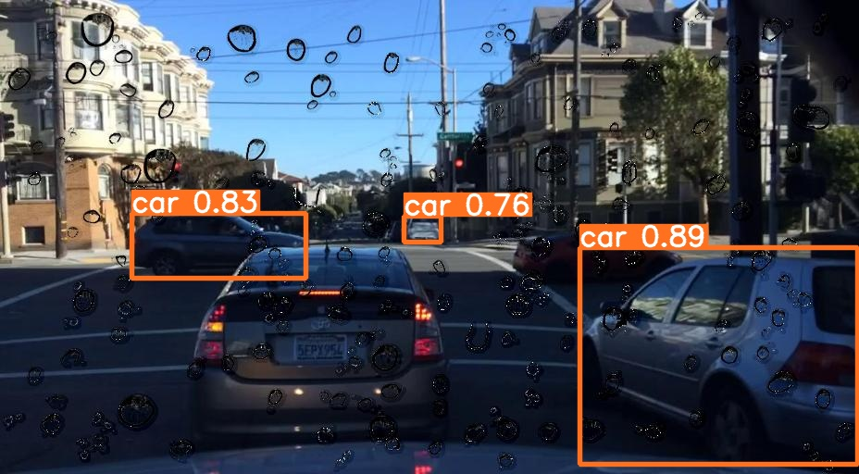
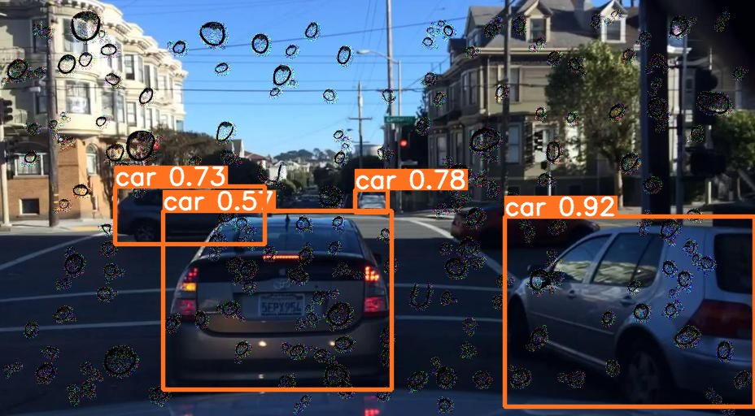
Results
Grey value
Gaussian
400
Original image
200

Slide 35
Future prospects
The detection for the untargeted classes gets reduced which should be addressed.
Try to implement physical version of this attack.
Different templates according to context can be experimented with.

Slide 36
Reference
[1] Simen Thys, Wiebe Van Ranst, and Toon Goedeme. Fooling automated surveillance cameras: adversarial patches to attack person detection. In Proceedings of the IEEE Conference on Computer Vision and Pattern Recognition Workshops, pages 0–0, 2019.
[2] Zuxuan Wu, Ser-Nam Lim, Larry Davis, and Tom Goldstein. Making an invisibility cloak: Real world adversarial attacks on object detectors. arXiv preprint arXiv:1910.14667, 2019.
[3] Kaidi Xu, Gaoyuan Zhang, Sijia Liu, Quanfu Fan, Mengshu Sun, Hongge Chen, Pin-Yu Chen, Yanzhi Wang, and Xue Lin. Adversarial t-shirt! evading person detectors in a physical world. arXiv, pages arXiv–1910, 2019
[4] Shang-Tse Chen, Cory Cornelius, Jason Martin, and Duen Horng Polo Chau. Shapeshifter: Robust physical adversarial attack on faster r-cnn object detector. In Joint European Conference on Machine Learning and Knowledge Discovery in Databases, pages 52–68. Springer, 2018.
[5]Huang, Hao, et al. "Rpattack: Refined patch attack on general object detectors." 2021 IEEE International Conference on Multimedia and Expo (ICME). IEEE, 2021.
[6] Brown, Tom B., et al. "Adversarial patch." arXiv preprint arXiv:1712.09665 (2017)
[7] Liu, Aishan, et al. "Perceptual-sensitive gan for generating adversarial patches." Proceedings of the AAAI conference on artificial intelligence. Vol. 33. No. 01. 2019.
[8 Sharif, Mahmood, et al. "Accessorize to a crime: Real and stealthy attacks on state-of-the-art face recognition." Proceedings of the 2016 acm sigsac conference on computer and communications security. 2016.]
[9] Karmon, Danny, Daniel Zoran, and Yoav Goldberg. "Lavan: Localized and visible adversarial noise." International Conference on Machine Learning. PMLR, 2018.
[10] Bai, Tao, Jinqi Luo, and Jun Zhao. "Inconspicuous adversarial patches for fooling image-recognition systems on mobile devices." IEEE Internet of Things Journal 9.12 (2021): 9515-9524.

Slide 37
Reference
[11] Alon Zolfi, Moshe Kravchik, Yuval Elovici, and Asaf Shabtai. The translucent patch: A physical and universal attack on object detectors. In Proceedings of the IEEE/CVF Conference on Computer Vision and Pattern Recognition, pages 15232–15241, 2021.

Slide 38
Thank you

